Slide 1
Enhanced E-R Model

Slide 2
Introduction
Today the complexity of the data is increasing, so it becomes more and more difficult to use the traditional ER model for database modeling.
To reduce this complexity of modeling, improvements or enhancements were made to the existing ER model to make it able to handle the complex application in a better way.
Hence, as part of the Enhanced ER Model, along with other improvements, 3 new concepts were added to the existing ER Model, they were:
Generalization
Specialization
Aggregation

Slide 3
Generalization
It is a form of abstraction that specifies that 2 or more entities that share common attributes can be generalized into a higher-level entity type, called SUPER TYPE or GENERIC TYPE.
The lower level of entities becomes the SUBTYPE(or categories) to the super type. Subtypes are dependent entities. Generalization is used to emphasize the similarities among lower-level entity sets and to hide differences.
It makes ER diagram simpler because shared attributes are not repeated.
It is denoted through a triangle component labeled “IS A” as shown in the example in next slide.
It is a bottom down approach, in which two lower level entities combine to form a higher level entity.

Slide 4
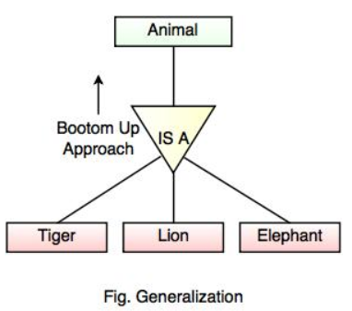
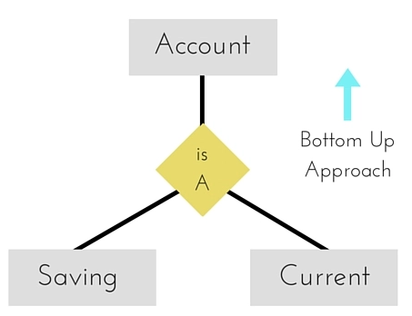
Example of Generalization

Slide 5
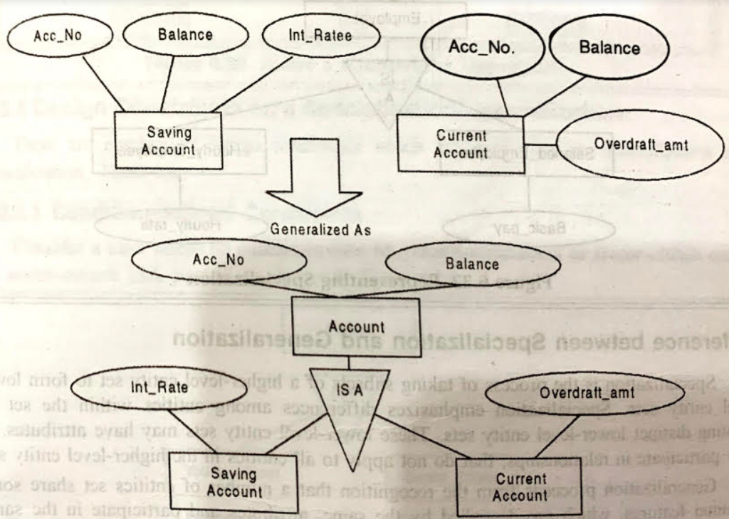

Slide 6
Specialization
Specialization is the process of taking subsets of a higher-level entity set to form lower level entity sets.
It is a process of defining a set of subclasses of an entity type, which is SUPERCLASS of specialization.
The process of defining subclass is based on the basis of some distinguish characteristics of entities in the super class.
It is a top down approach, in which one higher entity can be broken down into two lower level entity.

Slide 7
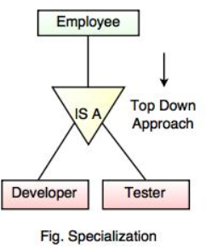
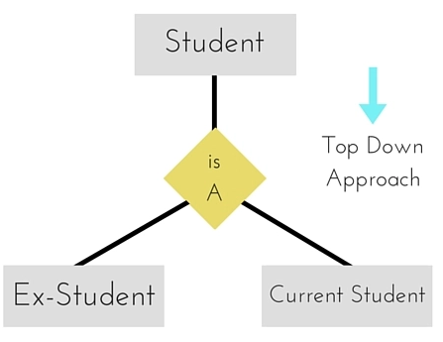
Example of Specialization

Slide 8
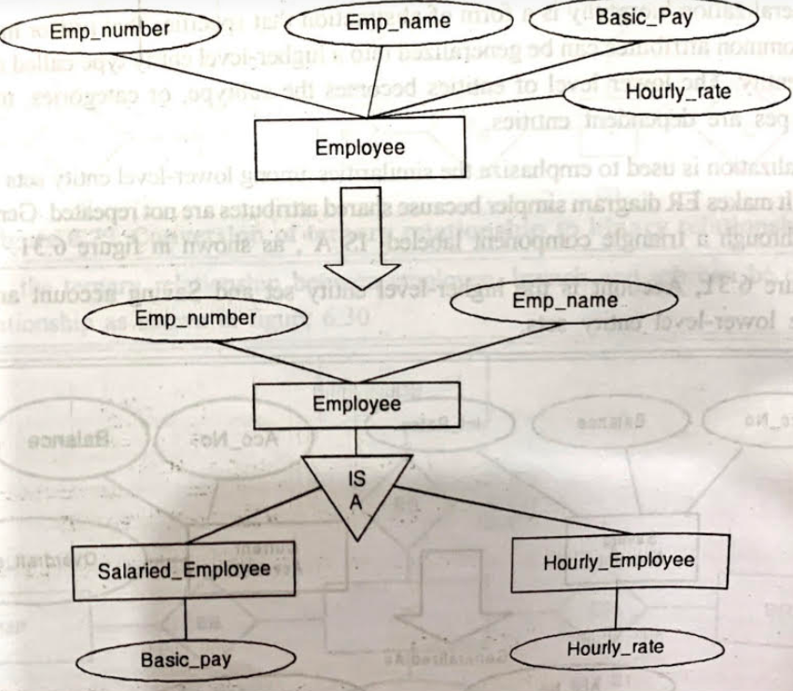
In below example, specialization of Employee entity type yields the set of subclass namely Salaried_Employee and Hourly_Employee on the method of pay.

Slide 9
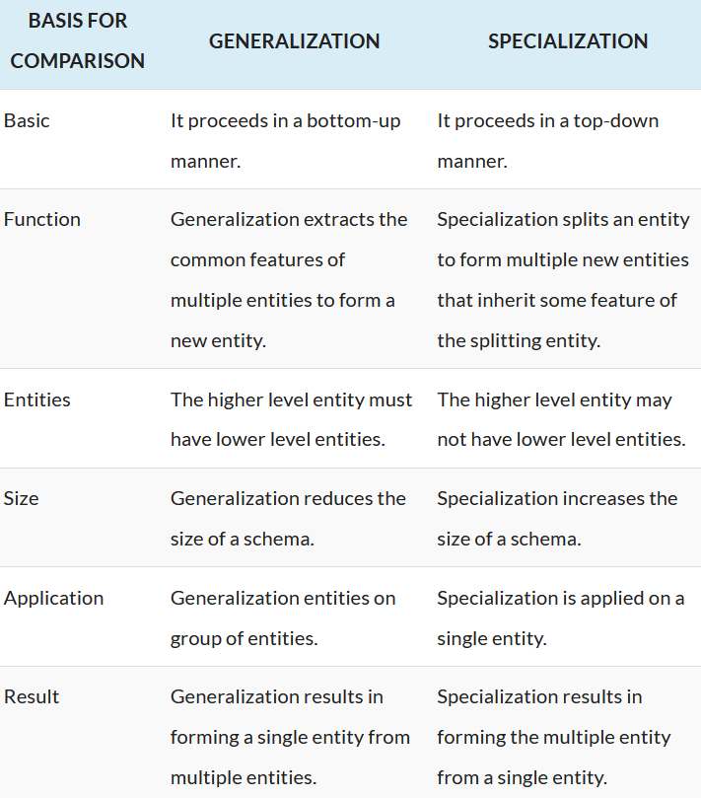

Slide 10
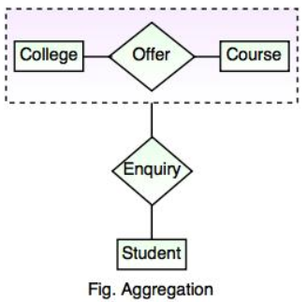
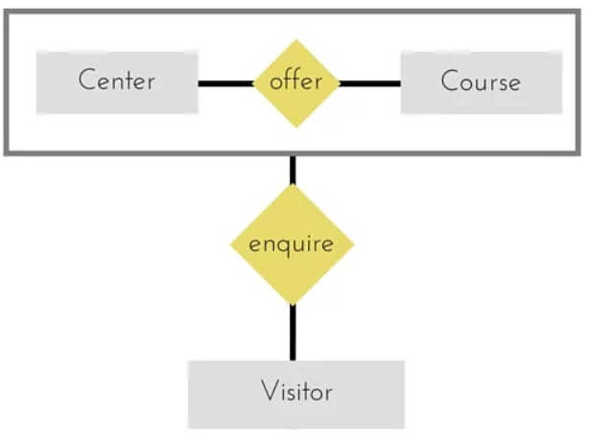
Aggregation
Aggregation is a process when relation between two entities is treated as a single entity.
It is the process of compiling information on an object, thereby abstracting a higher-level object.
Example: Below figure shows the notation for aggregation
Relationship between Center and Course together, is acting as an Entity, which is in relationship with another entity Visitor.

Slide 11
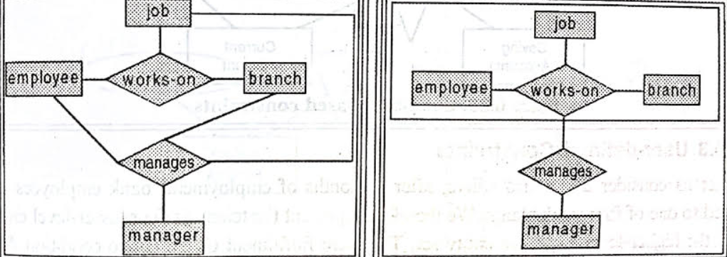
Notation for aggregation

